Slide 1
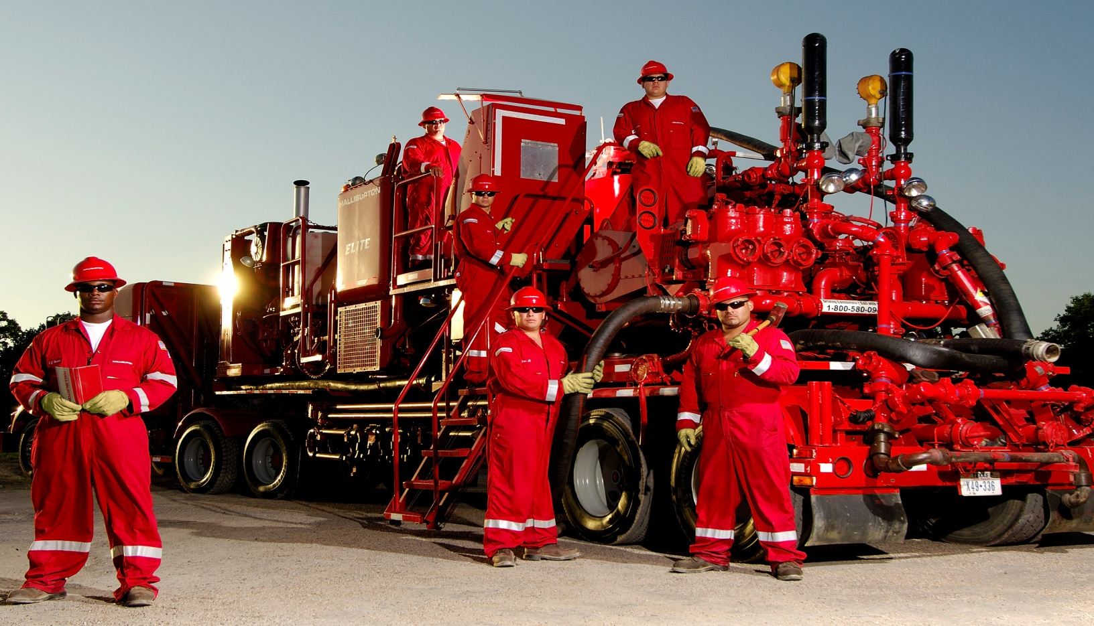
HALLIBURTON WILLISTON North Dakota
CURRENT OPEN POSITIONS
City | Req | Job Title
Williston | 65644 | Site Resource Planner
Williston | 66534 | Associate Procurement Specialist
Stanley | 66579 | Chemical Account Manager I
Williston | 67116 | Operator Asst II-Svc II - Coiled Tubing
Williston | 67120 | Field Service Rep III-Field Prof II - Drilling Fluids
Williston | 67358 | Service Supervisor I-II - Cementing
Williston | 67648 | Service Specialist I-III - Coiled Tubing
Williston | 67821 | Service Operator I-II - Cementing
Williston | 67851 | Cementing Bulk Plant Operator I-III
Williston | 68179 | Sales Manager
Williston | 68533 | Operator Assistant II-Wireline
Williston | 68976 | Operator Assistant Trainee-Cementing
Williston | 68995 | Shop Assistant
Williston | 69009 | Operator Assistant TRAINEE-Wireline
Williston | 69010 | Operator Assistant Trainee-Frac/Acid
Williston | 69301 | Service Supervisor I-III - Coiled Tubing
Dickinson | 69530 | Delivery Truck Driver - MultiChem
Williston | 69531 | Crane Operator I - PWR
Williston | 69588 | Operator Assistant Trainee-Coiled Tubing
Stanley | 69584 | Delivery Truck Driver I-MuliChem
Williston | 69867 | Service Leader - Frac/Acid
Williston | 64399 | Maintenance Parts Technician I-II
Williston | 67479 | Associate Mechanic Technician I-II
Apply to the current job openings at www.halliburton.com/careers
Search by requisition number or Williston location

